Slide 1

INTELLIGENT SOCIAL SURVEILLANCE SYSTEM
CREATED BY –
DEV RAMCHANDANI (EN18CS301078)
DHRUV BOTHRA (EN18CS301079)
DHRUVANSH MOYAL (EN18CS301080)

Slide 2
INTRODUCTION
In today's day and age, when people have begun to rely more on technologies that are called smart, meaning that they can operate and learn on their own at the command of humans and do the needed duties, we have achieved this new step with the assistance of computer vision and deep learning. In planning, operation, and sustainability of contemporary industrial and urban areas, video surveillance is a major factor. The efficiency, safety, security, and optimality of the region, infrastructures, persons, operations, and activities are all aided by video surveillance.
One of the main worries of today's citizens is security. In our system, we've combined three functionalities that have proven to be important in today's world. In order to try and address some problems of the new common world, we built a working prototype of a multi-purpose smart surveillance system that can be used to detect multiple anomalies in real-time and can be used anywhere from a crowded public space to a quiet museum with a reasonable number of people in the room.

Slide 3
PROBLEM STATEMENT
Nowadays, people want one sole thing that is to make them feel safe and secure. The most commonly used security system is the CCTV (closed circuit television). The cost of implementation of CCTV varies depending upon the size and use of the system. It is usually installed in hospitals, malls, parking lots etc. However, with the help of CCTV one can monitor the area 24/7, or the footage if stored in a location can be retrieved when required. Although, it can be used to deter crime and allows the authorities to identify and solve a crime, it doesn’t detect neither recognize the person who is involved. We have implemented a system which provides both face detection and face recognition with the help of Raspberry pi 3 which is a credit card sized minicomputer and a Pi camera which is made especially for the raspberry pi 3. Thus, when dealing with the real-time image processing, Open-source computer vision (OpenCV) software, a powerful library of image processing tools, is a good choice. With the help of a smart surveillance system, we have achieved a system that can record the event, detect and recognize the person.

Slide 4
RELATED WORK
Real Time Face Detection and Tracking Using OpenCV Context : In this paper, we intend to Implement a real-time Face detection and tracking the head poses position from high-definition video using Haar Classifier through Raspberry Pi BCM2835 CPU processor which is a combination of SoC with GPU based Architecture. SimpleCV and OpenCV libraries are used for face detection and tracking the head poses position.
Enhanced Home Security Using IOT and Raspberry PI Context : The improvement in security aspect offers innovative and productive scope to the means of living. All these characteristics is adapted by using Internet of Things (IoT) and Raspberry Pi. The recognition problem is always questionable in smart home applications. So, a recovery is done to identify the intruder as known or unknown by the use of image processing techniques for face recognition.

Slide 5
Smart Surveillance Camera using Raspberry Pi 2 and OpenCV Context : The existing system is a cost-effective method that uses a credit card sized chip RPI. The existing system has accuracy of about 83 %. In this project we propose to use an enhanced recent model- raspberry pi 2 which has operating speed 900MHz. Also, we use a pi camera. So, the image is captured via the pi camera and then, the face detected is compared with the database. Thus, one can provide a low-cost security system.
Survey Paper on Smart Surveillance System Context : This paper deals with the survey of Smart surveillance monitoring system using Raspberry pi. The current technologies require RFIDs which are costly and hence the security domain in all becomes expensive. This paper describes the use of low-cost single on-board computer Raspberry Pi. This new technology is less expensive and, in this project, it is used as a standalone platform for image processing. It increases the usage of mobile technology to provide essential security to our homes and for other control applications. The proposed home security system captures information and transmits it via a 3G Dongle to a Smart Phone using web application Raspberry pi.

Slide 6
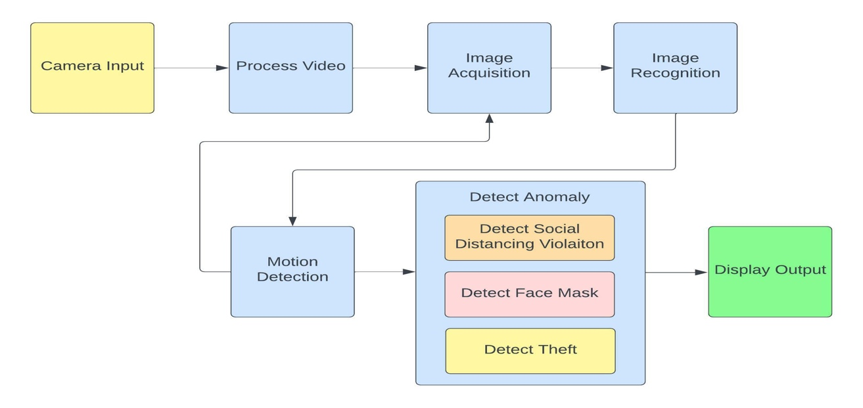
PROPOSED METHOD
The suggested research is built using Python 3, OpenCV, and the flask framework of python. Using OpenCV's machine learning methods, we can educate the machine to discern between diverse user use cases and unauthorized offenders' unique undesired conduct, allowing us to take appropriate action based on the context. We are able to effectively use logic to execute the artificial intelligence idea at hand to recognize and classify the events that occur using image processing strategies and mathematical deductions.
Figure 1: Block Diagram

Slide 7
Scope of the Work
This system has a wide range of uses in various fields, such as banking, forensic department, etc. The reason this system is quiet useful is due to the fact that it is highly compact and it provides face detection and an instant notification about the same through email. To obtain the database, first collect the images of the subject individual for the recognition. Once we obtain and train our system, we can provide face recognition. Once the face is recognized, it is checked to see if the detected face is familiar or not. Thus we integrate the face detection and recognition to provide a smart surveillance system for the domestic purposes in our everyday life.

Slide 8
Requirements
SOFTWARE REQUIREMENTS:
OS : Windows
Coding Language : Python
Library : OpenCV, Tensorflow
HARDWARE REQUIREMENTS:
CPU :4 ARM Cortex-A53, 1.2GHz
GPU: Broadcom VideoCore IV
RAM: 1GB LPDDR2 (900 MHz)
Camera: Raspberry Pi Camera Module

Slide 9
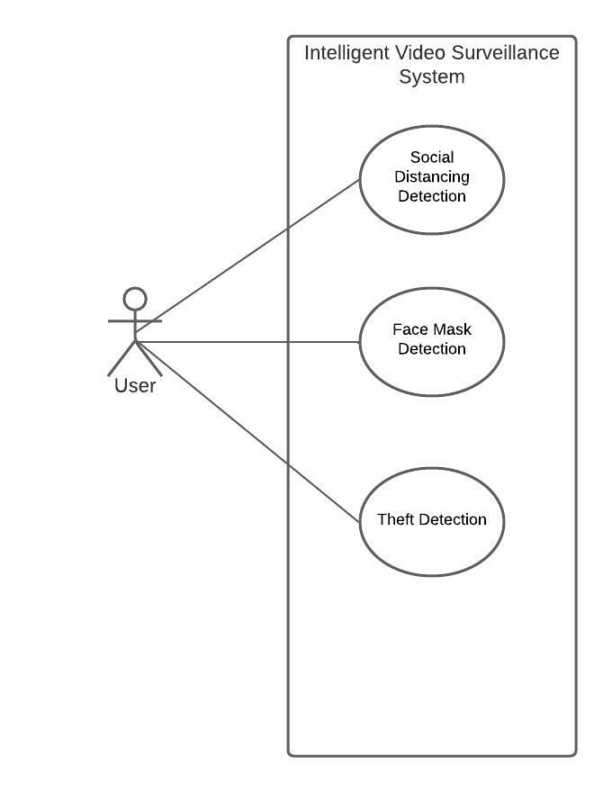
Use Case Diagram:
Figure 2: Use Case Diagram

Slide 10
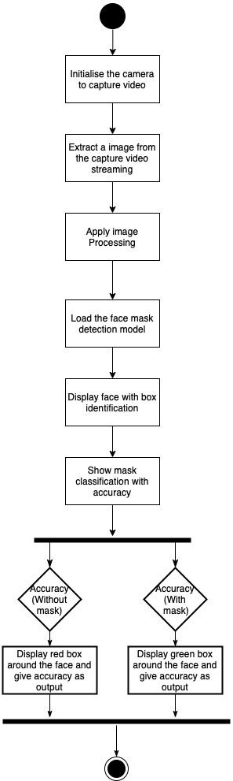
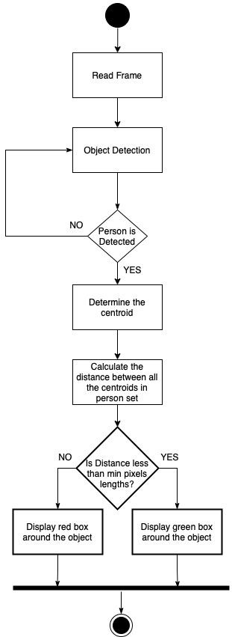
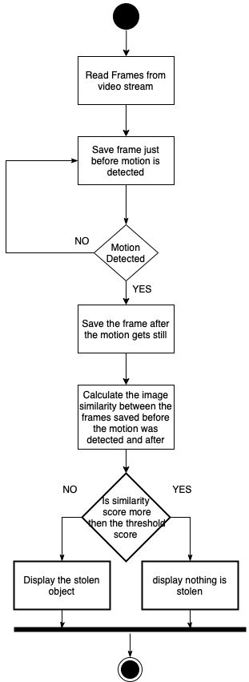
Activity Diagram
Figure 3: Activity diagram for face mask detection
Figure 4: Activity diagram for Social distancing detection
Figure 5: Activity diagram for theft detection

Slide 11
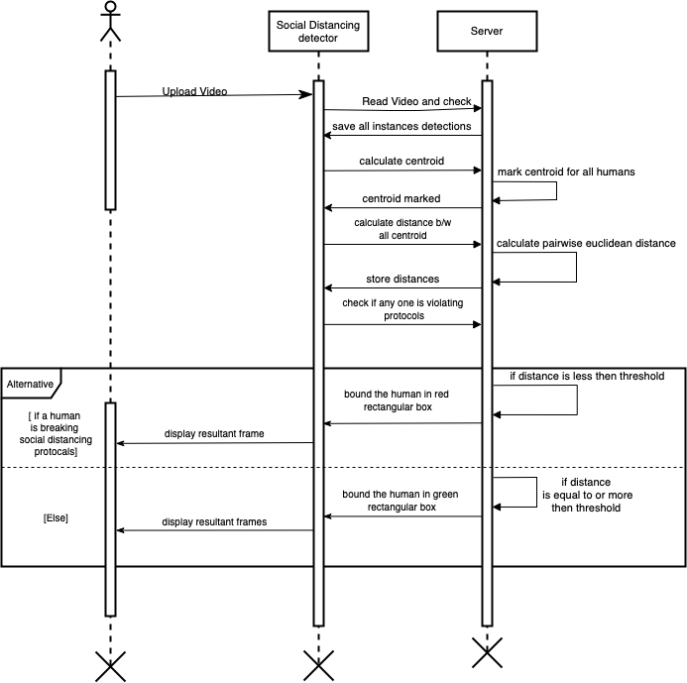
Sequence Diagrams
Figure 6: Sequence diagram for Social distancing detection

Slide 12
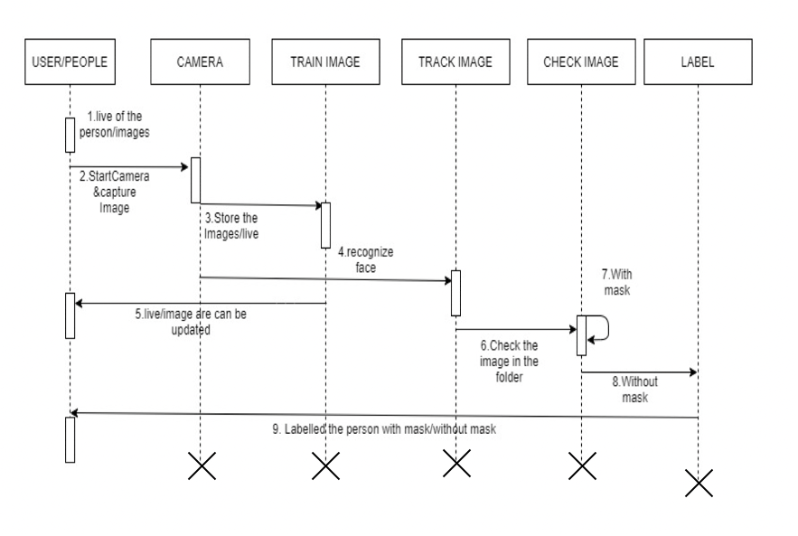
Figure 7: Sequence diagram for face mask detection

Slide 13
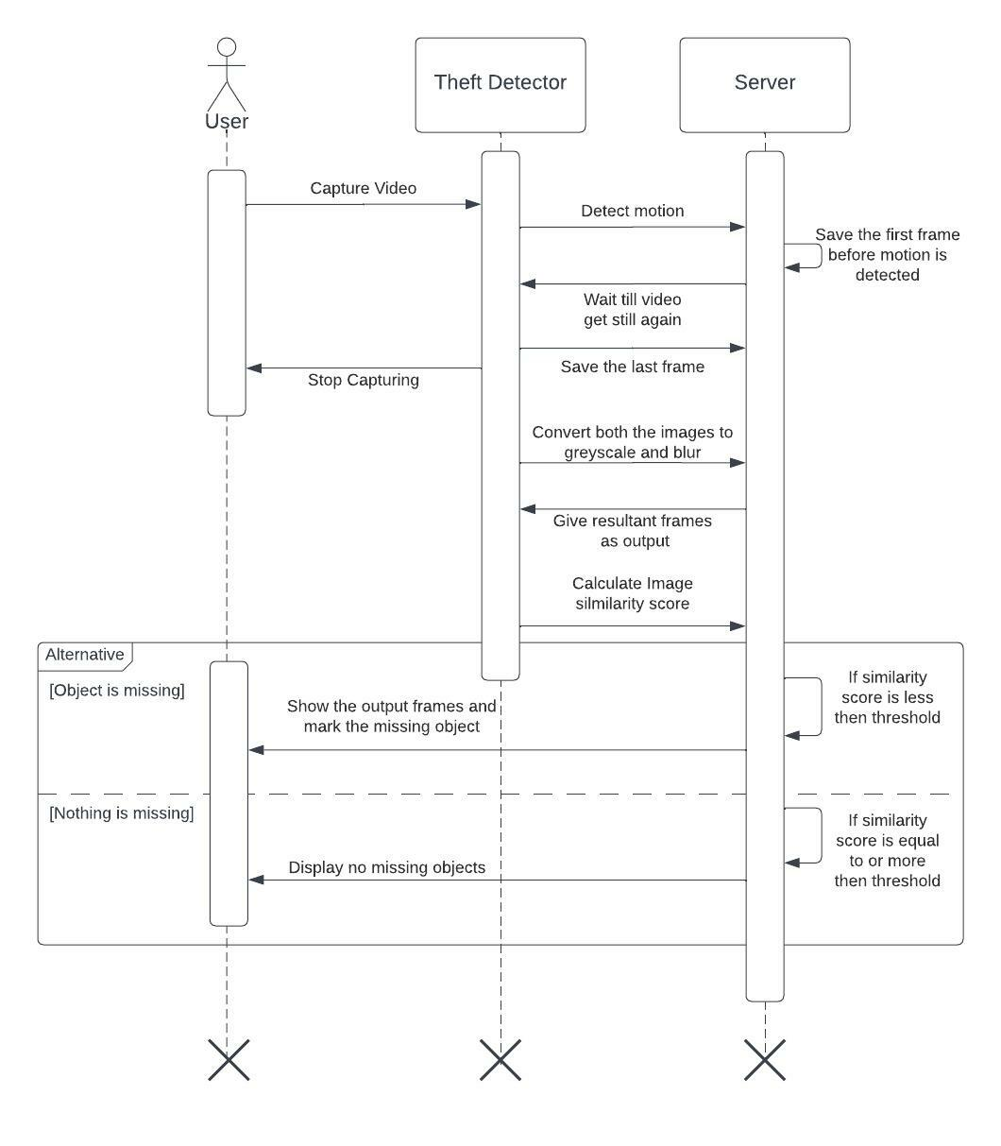
Figure 8: Sequence diagram for theft detection

Slide 14
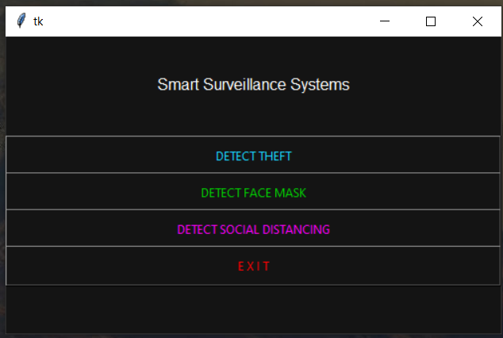
Result And Discussion:
Figure 9: GUI made using tkinter

Slide 15
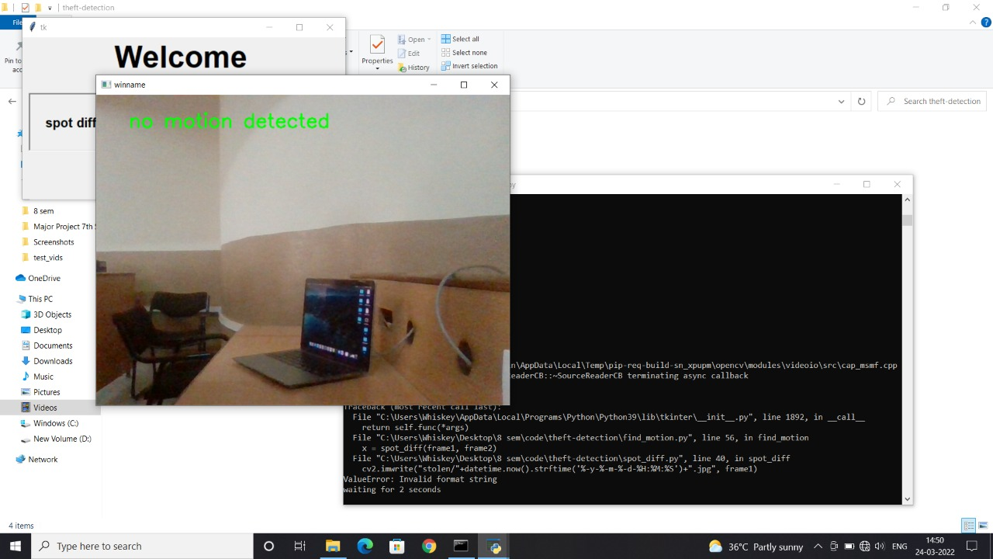
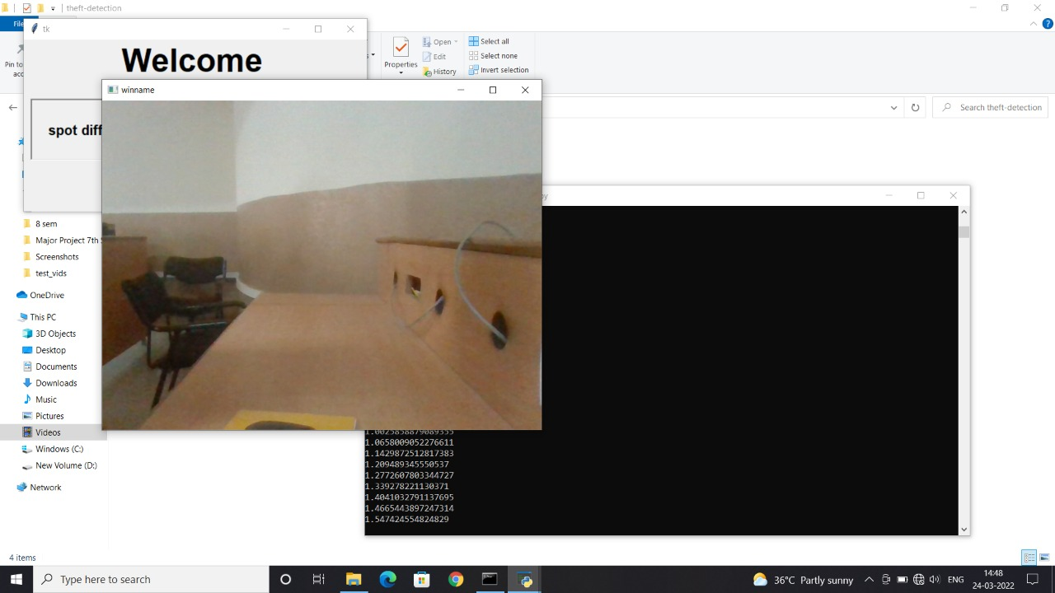
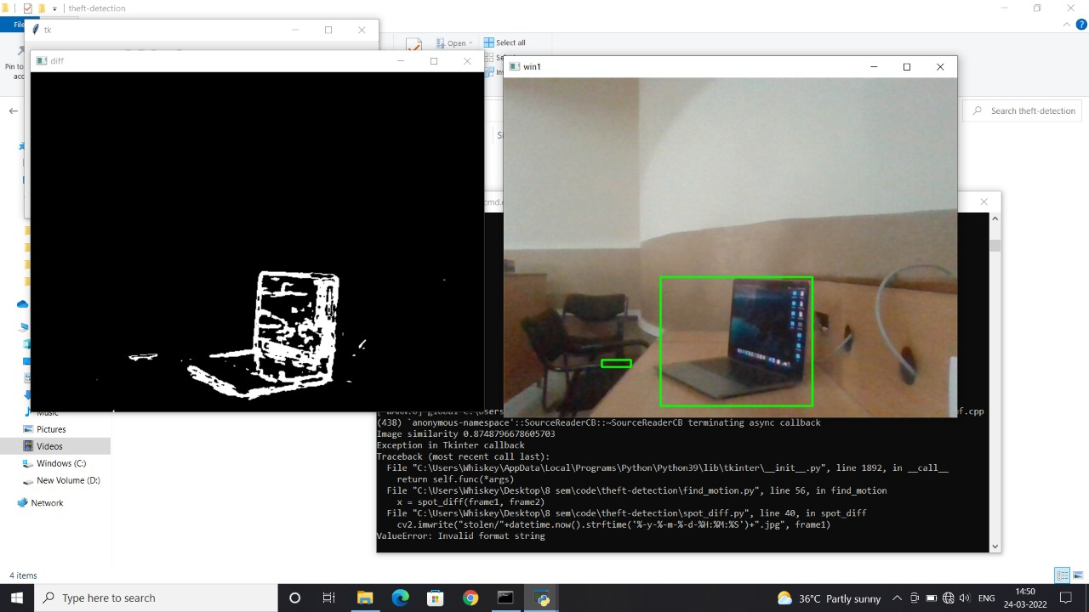
Figure 10: Result of theft detection

Slide 16
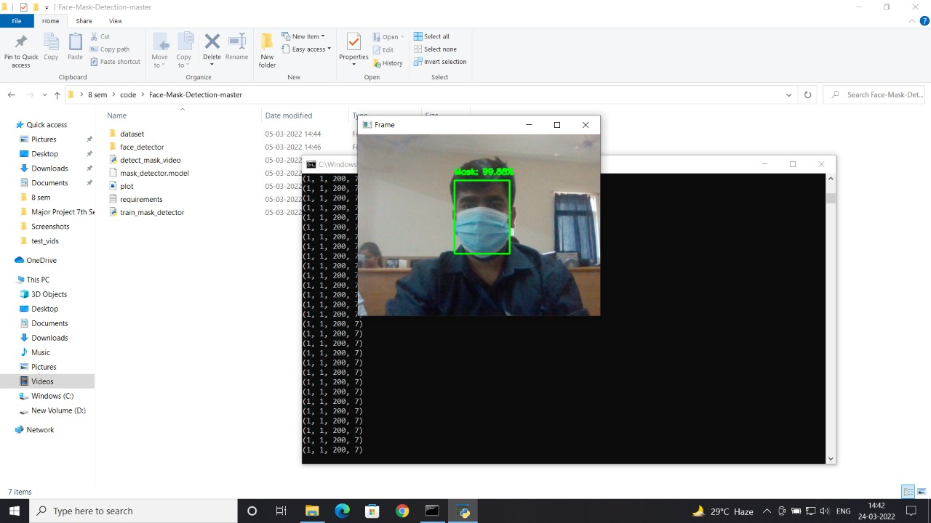
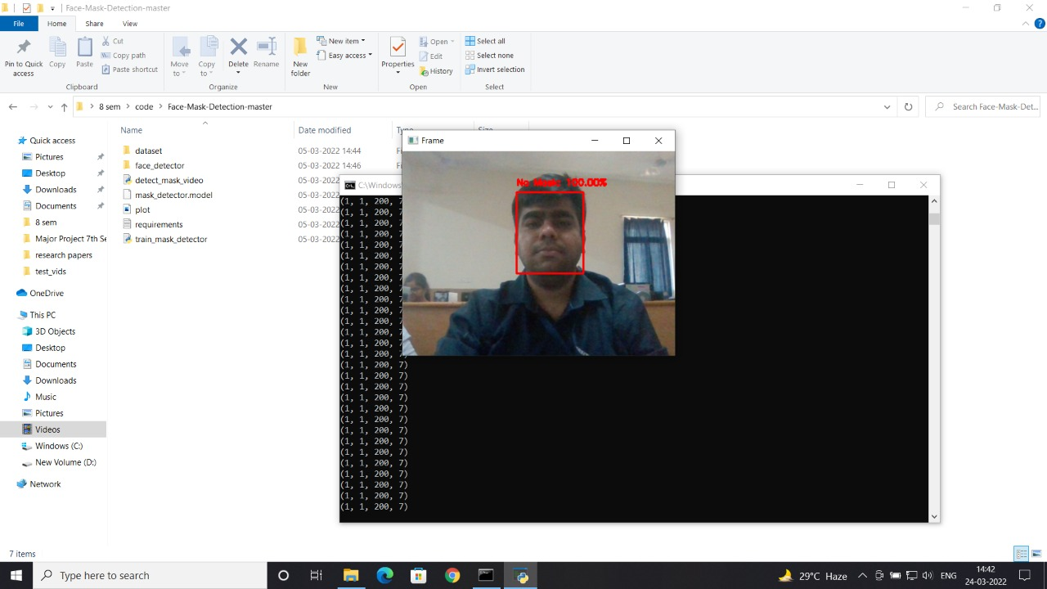
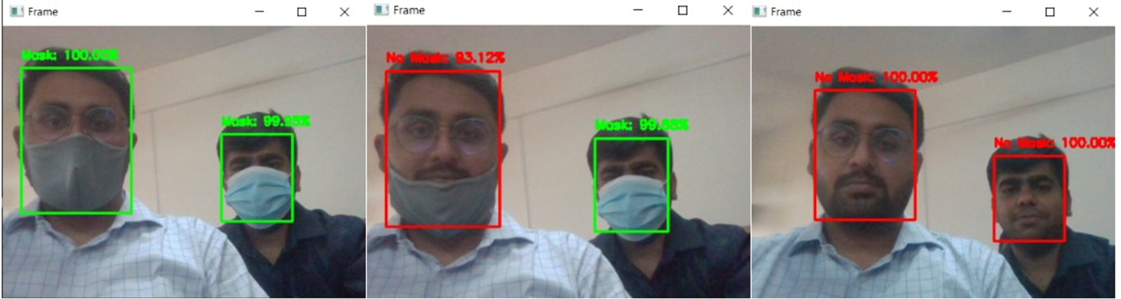
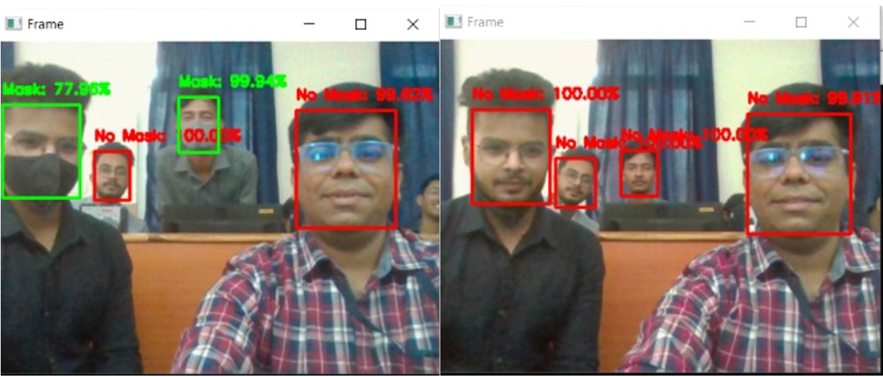
Figure 11: Result of face mask detection

Slide 17
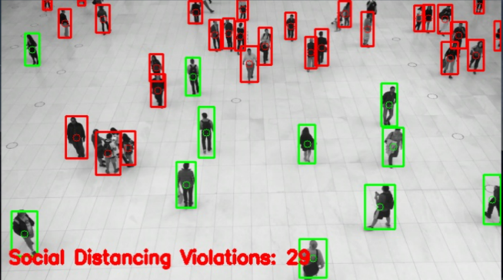
Figure 12: Result of social distancing detection

Slide 18
Technical discussion
A CCTV camera collected the area of interest (ROI) of an image or video frame centred on a person walking, which was then converted into a two-dimensional bird's perspective. On both sides, the modified view is 480 pixels wide. The Deep Convolutional Neural Networks model for object detection is a simple and effective approach. This model solely takes into account areas that include just the "Person" class and ignores regions that are unlikely to contain any objects. Region Proposals is the process of extracting just the areas that include the objects. The size of the areas anticipated by region proposal can vary, and they may overlap with other regions. So, based on the Intersection Over Union (IOU) score, maximal non suppression is utilised to disregard the bounding boxes surrounding the overlapping region. In a single frame, there are several objects; the aim is to find "Solely Person" class map bounding boxes that are only connected to people. Once the bounding box for each person is mapped, the interval between the set of persons in an input frame may be readily determined. The orientation in the bird's perspective transformation is determined for each individual in the input frame based on the central axis point of each person in the input frame. From a bird's eye view, the Euclidean distance between centroids may be used to determine the distance between each group of individuals. More accurate findings can be obtained when the camera is calibrated. If the result achieved using the preceding approach is less than the minimum permissible threshold value, a red box is drawn around the group of individuals.

Slide 19
References
World Health Organization, “Coronavirus Disease 2019,” Coronavirus disease (COVID-19) pandemic, 2020.
M. Ministry of Health, “COVID-19 MALAYSIA,” http://covid-19.moh.gov.my/.
H. H. Naz, “Social distancing enforced on all RapidKL trains,” NST, 2020.
The Star, “‘Be ready for stricter MCO,’” The Star, 2020.
Australian Government, “Prohibited, restricted and danger areas _ Civil Aviation Safety Authority.”
D. Ganiger, K. A. Patil, P. Patil, and M. Anandhalli, “Automatic Control of Power Supply in Classroom Using Image Processing”.
S. Khedkar and G. M. Malwatkar, “Using Raspberry Pi and GSM Survey on Home Automation,”
S. Suresh, H. N. S. Anusha, T. Rajath, P. Soundarya, and S. V. P. Vudatha, “Automatic lighting and Control System for Classroom,”
V. S. Rao and S. S. Kowshik, “PIR Sensor Characterization and a Novel Localization Technique using PIRs,”
M. Habaebi, R. Rosli, and M. R. Islam, “RSSI-based human presence detection system for energy saving automation,”
H. Fan, H. Zhu, and D. Yuan, “People Counting in Elevator Car Based on Computer Vision,”

Slide 20
Thank You

